Slide 1
Cyber ATTACK Behaviors & Country of Origin
Samantha Roberts

Slide 2
introduction
Cybersecurity topics have reached notoriety as the technology industry has exploded.
Terms like “hacker” and “computer virus” can be translated into over 80 languages.
It can be found in our entertainment, politics, economics, business affairs, and academia.
Cybersecurity and Psychology:
Identify behavior patterns, trends, and tactics to predict individual users.
Resource: Khosmood, Nico, & Woolery (2014) demonstrated the ability to identify a user based on command line history in a Unix Operating System.
Amazon Honeypot Attack Data
Dataset obtained from: https://www.kaggle.com/casimian2000/aws-honeypot-attack-data

Slide 3
Methodology
Data Processing
Original Dataset: 451,581 x 21
Post Data Processing: 69,968 x 9
Removed China and United States (77% of data)
Exploratory Data Analysis (EDA)
95 countries included
Destination port (dpt), Protocol Type, Host (region), Locale
Hyperparameter tuning
Logistic Regression, RandomForestClassifier, Support Vector Machine (SVM) – “SVC”, and Principle Component Analysis (PCA)
Model Selection and Results
Intel Distribution for Python (IDP) with Python 3.6, with packages to include:
pandas, numpy, matplotlib, seaborn, sklearn, time

Slide 4
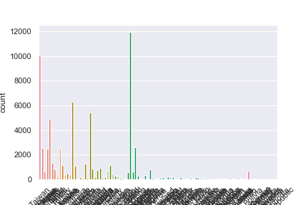
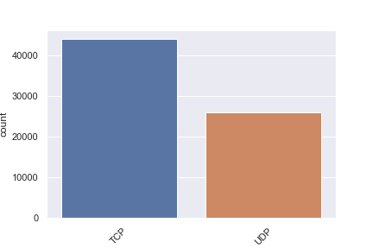
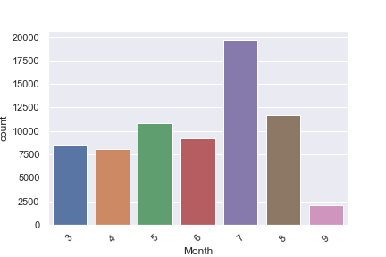
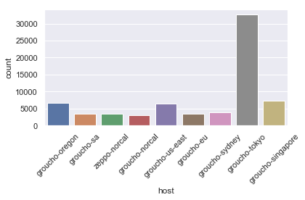
EDA

Slide 5
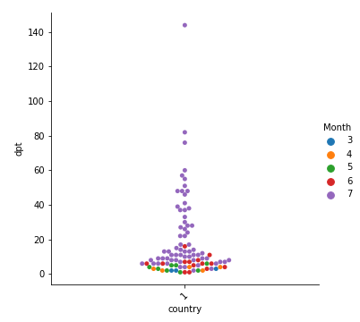
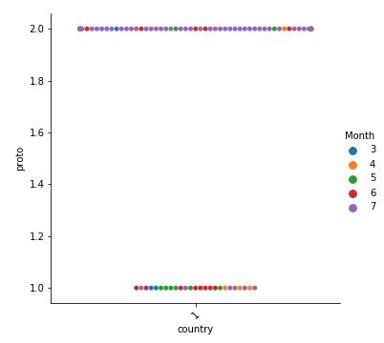
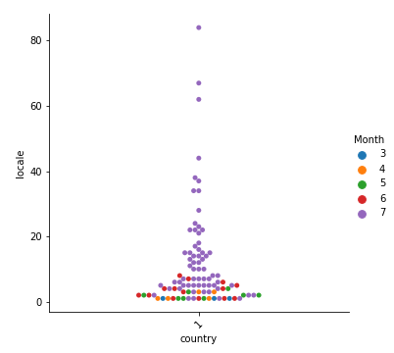
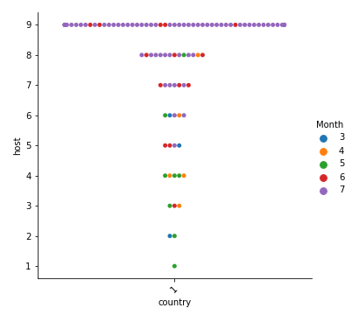
EDA

Slide 6
Results & Analysis
Model Variables:
Host, Destination Port, Month, Protocol Type
Hyperparameter Tuning
Sampled 100 from dataframe
Best Model: PCA w/ Logistic Regression
Accuracy Score: 0.35
Final Model Prediction Results:
Country:
Accuracy Score: 0.4
Locale (with Country removed):
Accuracy Score: 0.42
Locale (with Country included):
Accuracy Score: 0.55

Slide 7
conclusion
Outcome: PCA with Logistic Regression is capable of correctly predicting the country class 40% of the time based on the greater region data (host), destination port attacked, Month, count (of samples per country), and protocol type.
The hyperparameter tuning model used .1% of the available samples in the refined dataset, but only overestimated the accuracy of the model by roughly 5%.
Lessons Learned:
Resource intensive – CPU and Memory juggling
Train/Test splitting, several countries with less than 10 instances
Future Research Recommendations:
Identify socioeconomic events that may be indicative of a social group’s malicious behavior patterns.

Slide 8
QUESTIONS?

